Slide 1

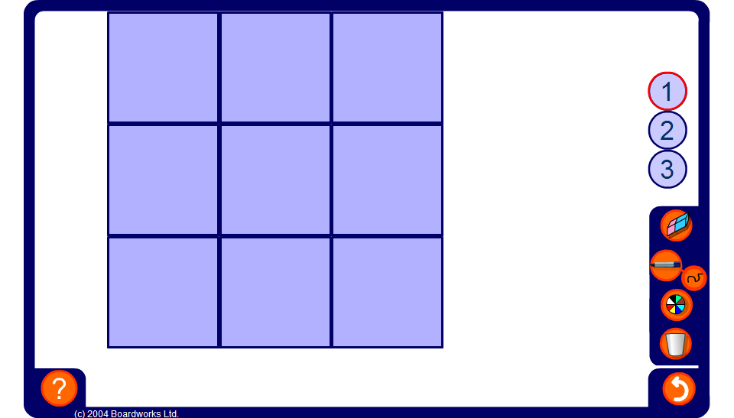


Algebraic magic square
Notes:
Remind pupils that in a magic square each row, column and diagonal has the same sum, called the ‘magic total’.
Start by working out the ‘magic total’ by revealing three expressions in any row column or diagonal. This can also be found by multiplying the expression in the centre by three.
Reveal the expressions in one or two more squares so that pupils have enough information to work out the missing expressions.
Clicking on each cell will reveal the missing expression.

